Slide 1
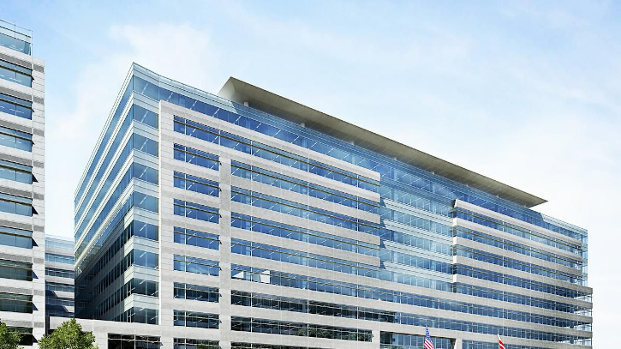

Federal Communications Commission Discussion Panel
National Regional Planning Council (NRPC)
Technical Seminar Program
Baltimore, Maryland
July 29, 2025

Slide 2

Contact Info
Federal Communications Commission
Public Safety and Homeland Security Bureau
Policy and Licensing Division
45 L Street NE, Washington, DC 20554
John Evanoff
Chief, Policy and Licensing Division
Phone: 202-418-0848
John.Evanoff@fcc.gov
Roberto Mussenden
Attorney Advisor
Phone: 202-418-1428
Roberto.Mussenden@fcc.gov
Brian Marenco
Electronics Engineer
Phone: 202-418-0838
Brian.Marenco@fcc.gov
Tracy Simmons
Electronics Engineer
Phone: 717-338-2657
Tracy.Simmons@fcc.gov

Slide 3
Topics for FCC Update
I.
Licensing Matters
II.
700 MHz and 800 MHz RPC Dockets
III.
4.9 GHz Data Collection
IV.
Question and Answer Session

Slide 4

Topics for FCC Update
I.
Licensing Matters

Slide 5

Licensing Matters
(By the Numbers)
Our Gettysburg team routinely processes a staggering amount of public safety applications:
Over 50,000 public safety applications in 2023
Over 52,000 in 2024
Over 27,500 so far this year (as of June 30, 2025).
The team processes 99% of the applications within 45 days of receipt.

Slide 6



Licensing Matters
(Invalid E-Mail Addresses)
In 2020, the Commission eliminated the mailing of paper courtesy reminder notices and other Universal Licensing System (ULS) correspondence to licensees.
Instead, it adopted rules mandating electronic delivery for all ULS compulsory and courtesy correspondence.
A licensee with an invalid e-mail addresses will not receive any courtesy reminder correspondence potentially leading to missed deadlines such as construction notifications or license renewal.

Slide 7
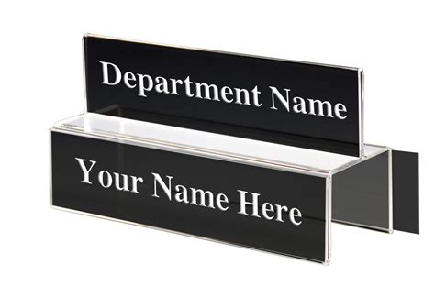


Licensing Issues
(Invalid E-Mail Addresses)
We request licensees update email addresses and list an agency or title email instead of a personal email, as personnel and job duties change which could lead to information being misdirected or stale.

Slide 8

Topics for FCC Update
II.
700 MHz and 800 MHz RPC Dockets

Slide 9
700 MHz and 800 MHz RPC Dockets
Just a reminder that the Bureau established PS Docket No. 23-237 as an administrative convenience to replace the previous 55 individual 800 MHz dockets established on a region-by region basis. Use this new docket for any future 800 MHz RPC filings.
800 MHz
700 MHz
The docket for 700 MHz RPC filings continues to be: WT Docket No. 02-378.

Slide 10


800 MHz RPC Docket Consolidation
A full listing of the previous 800 MHz docket numbers can be found at https://www.fcc.gov/public-safety-licensing [click on “Regional Planning Committees (RPC)”].
These dockets, even after closure, will still be searchable via the Commission’s Electronic Comment Filing System (ECFS) at https://www.fcc.gov/ecfs/search/search-filings.

Slide 11
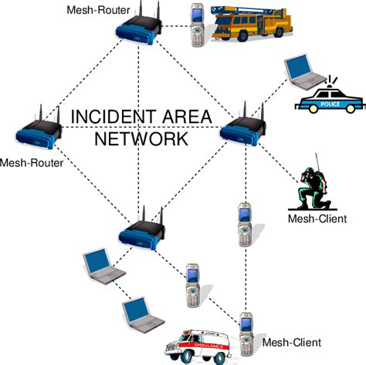
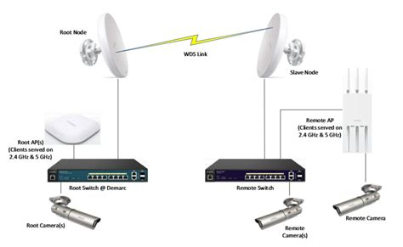
Topics for FCC Update
III.
4.9 GHz Data Collection

Slide 12


4.9 GHz Data Collection
4.9 GHz Band (4940-4990 MHz)
The Bureau is collecting granular technical data in ULS on all incumbent public safety deployments in the band.
Licensees have been filing applications under the newly-created radio service codes PB (Base/Mobile) or PF (Fixed Links).
The deadline for filing applications in ULS for existing operations was July 9, 2025.

Slide 13

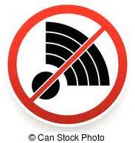
4.9 GHz Data Collection
Bureau staff is currently processing all pending 4.9 GHz applications including those which need a waiver.
Staff is currently reviewing approximately 3,200 pending PB and PF applications.
Once all applications are processed, the data collected in ULS will be used to ensure incumbent licensees can continue to operate in the band free from harmful interference.

Slide 14

IV.
Question and Answer Session

